Slide 1

Node where Data is fed - tf.placeholder

Slide 2
Reference
Youtube
Code

Slide 3
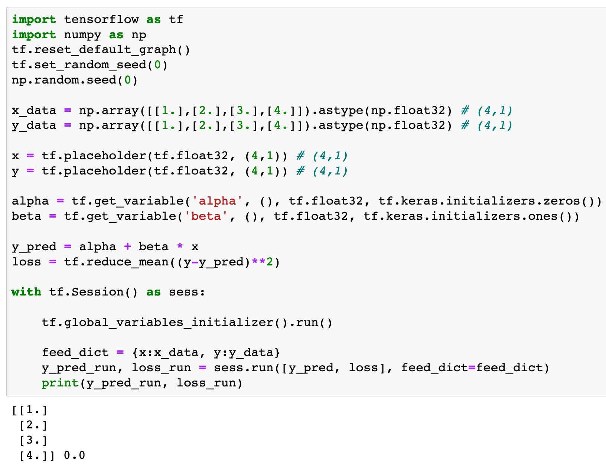

Slide 4
tf.placeholder

Slide 5
tf.placeholder
dtype

Slide 6
tf.placeholder
dtype
shape

Slide 7
None is Wild Card

Slide 8
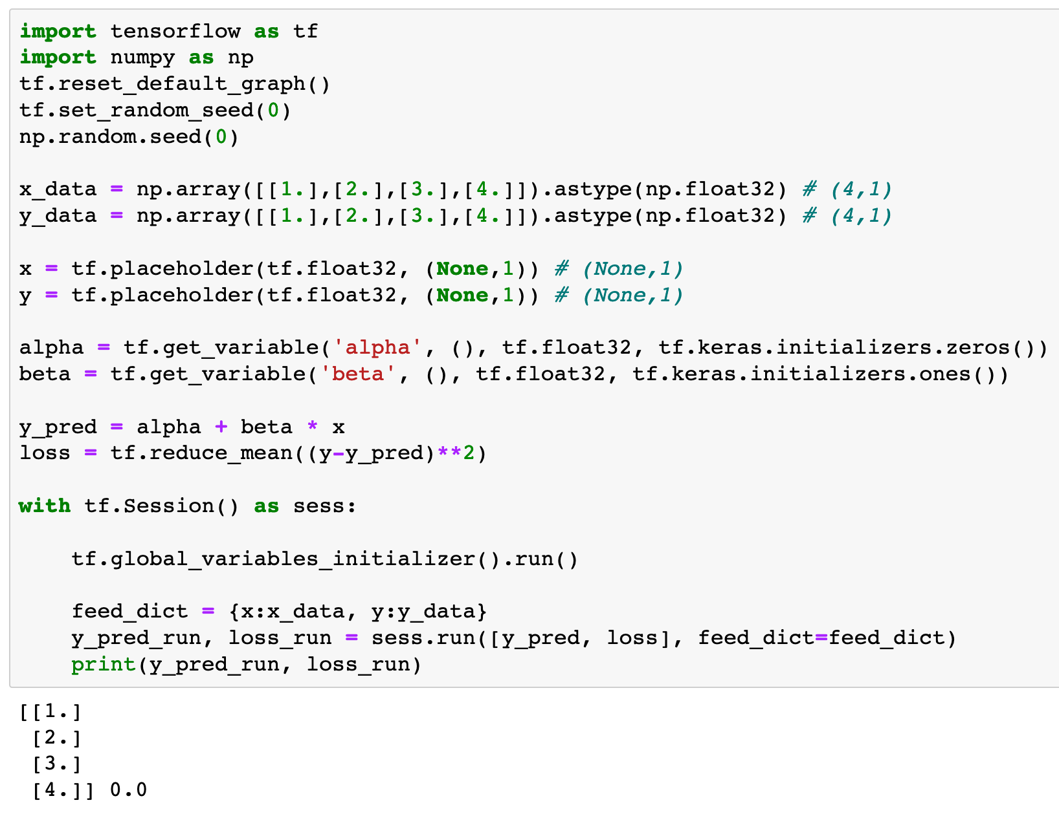
None is Wild Card

Slide 9
None is Wild Card

Slide 10
How to feed Data

Slide 11
Node where Data is fed

Slide 12
Data to feed
Node where Data is fed

Slide 13
feed_dict keyword

Slide 14
Data to feed in dict Form
feed_dict keyword

Slide 15
Now
Let’s Play with Code

